Slide 1
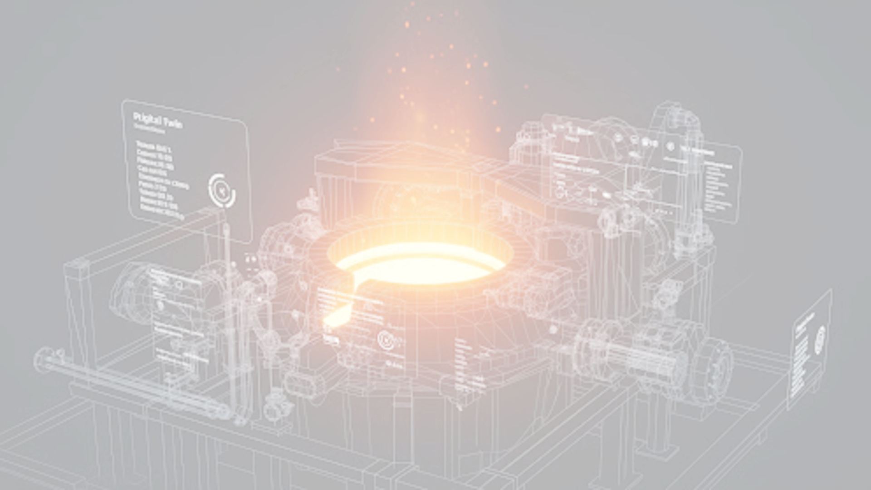
Heat Treatment Digital Twin
INDUSTRIAL AUTONOMY FRAMEWORK
Mukund Kumar

Slide 2

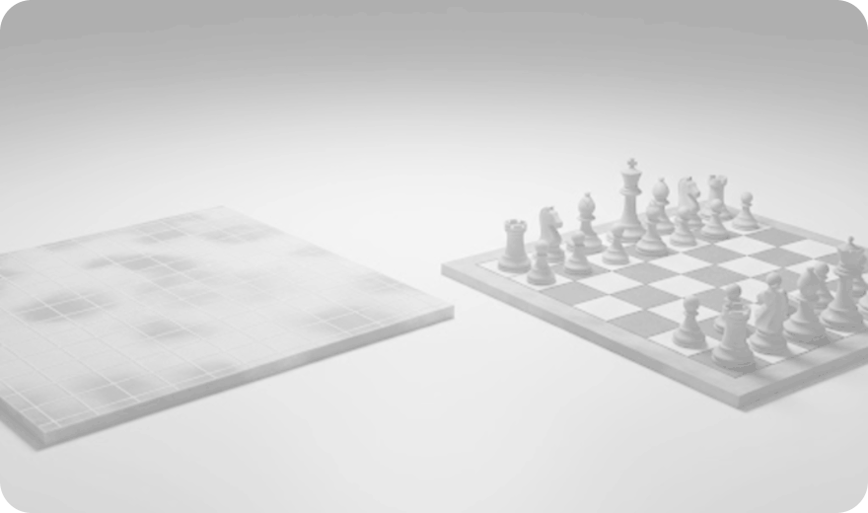
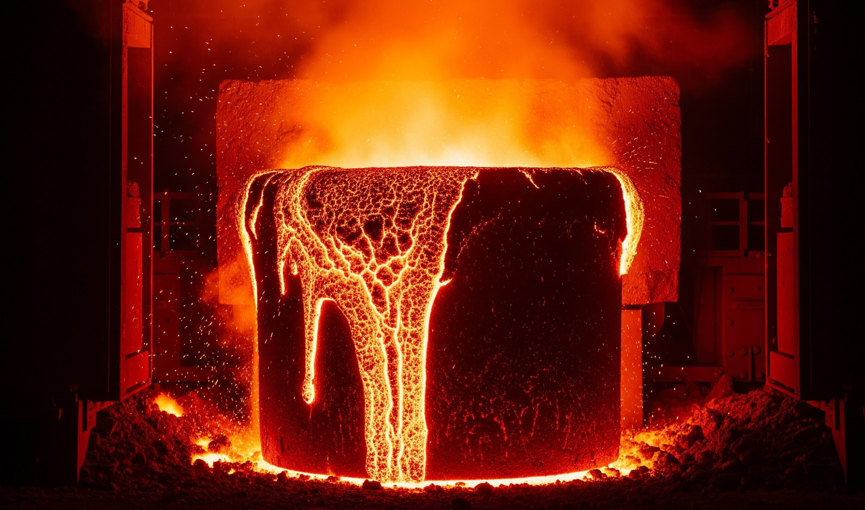
The Real World Has Inertia
Standard RL
Discrete, instantaneous state changes.
Physical Systems
Continuous, time-dependent dynamics with thermodynamic constraints.
The LLM Failure: Next-token thinking causes catastrophic melting.

Slide 3
Digital Twin: Continuous ODEs & SMDP
thermodynamics
Engine Architecture
Newton's Cooling:
d(T_mat)/dt = (h(t) * A * (T_furnace - T_mat)) / (m * Cp)
Arrhenius Oxidation:
d(ox)/dt = A_ox * exp(-E_ox / (R * (T_mat + 273)))
Arrhenius Equation:
k(T) = A * exp(-E / (R * (T_mat + 273)))
📁 heat_treatment_scheduler/
📄 materials.json
📄 hardware.json
SMDP CONTROL OUTPUT [ACTION, DURATION]
Physics Engine
solve_ivp Integrator
TEMP
850°C
TIME
45m
TEMP
400°C
TIME
12m
⚡ Semi-Markov Decision Process (Variable-Time Horizon)
⚙️ Configuration-Driven (Instant material/hardware swapping)
📊 Powered by scipy.integrate.solve_ivp

Slide 4
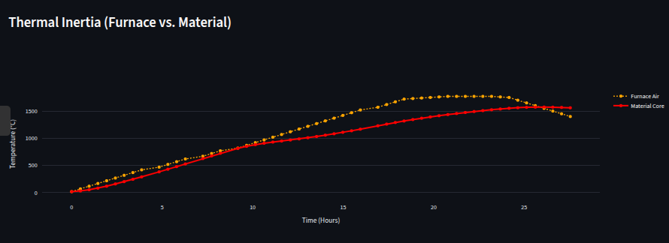
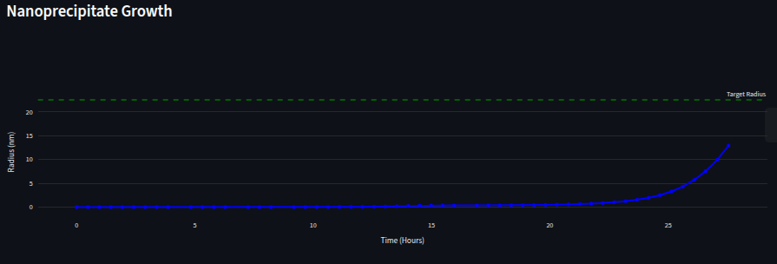
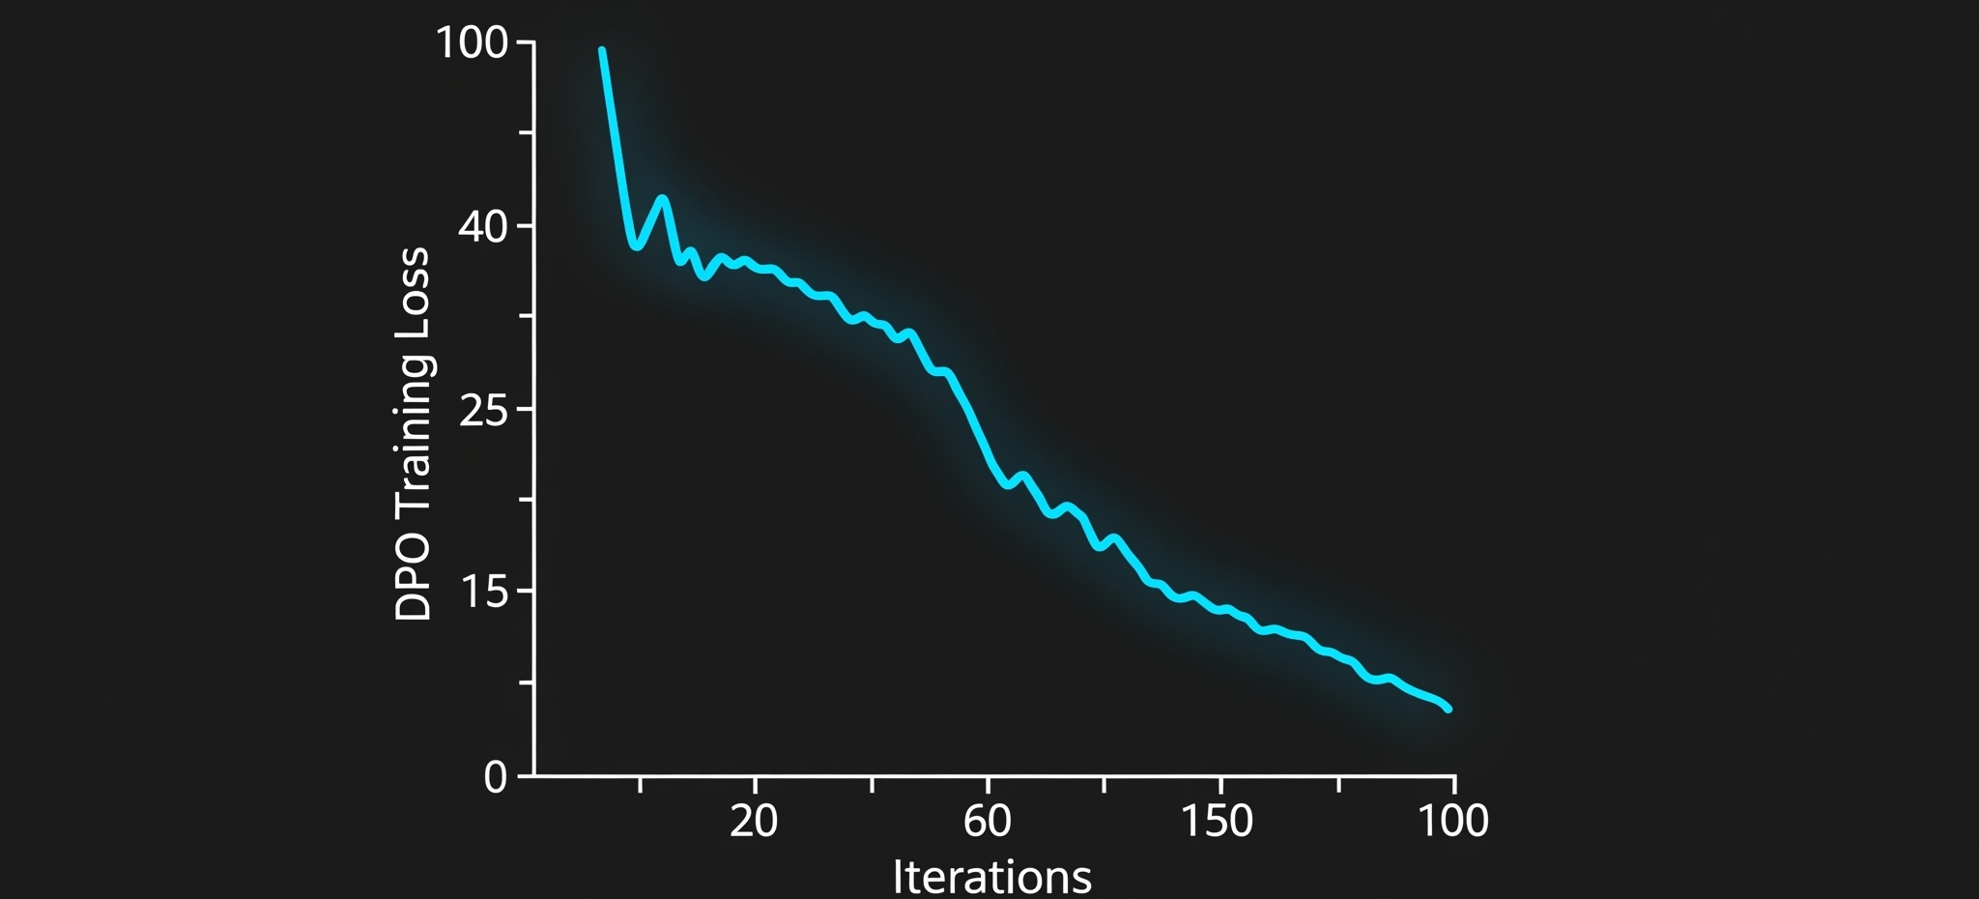
Teaching Agents "Predictive Braking"
The Dataset
Frontier LLM Successes vs. Thermal Lag Failures
The Pipeline
Unsloth + Hugging Face TRL
peft_config = LoraConfig(r=16, ...)
The Result
Llama-3-8B learns physical momentum
LOSS: 0.198RUNTIME: 16m

Slide 5
Heat Treatment Digital Twin (V2)
LLM Agent
Llama-3-8B
FastAPI
OpenEnv Bridge
ODE Engine
Physics Solver
Telemetry
Reward Signal
Architecture Summary
Long-Horizon Planning: Strategic heat cycles managed via SMDP.
Built for OpenEnv: Standardized interface for industrial gym environments.
Multi-Agent Scaling: Modular design ready for swarm orchestration.
SCAN FOR GITHUB REPO

